Slide 1
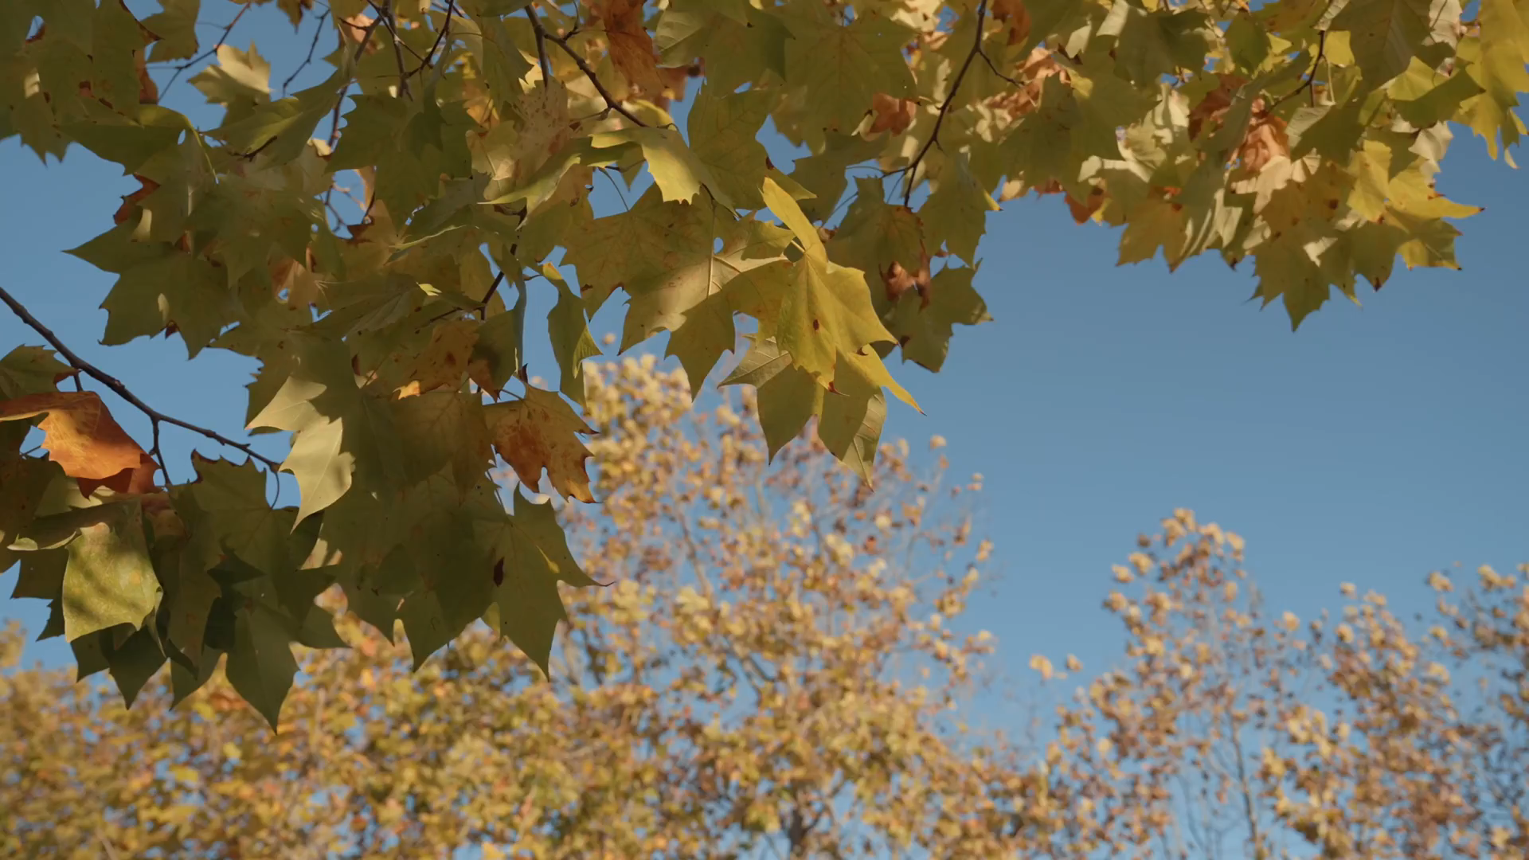
PRESENTATION
STUDY
N
K
U
TRIP

Slide 2
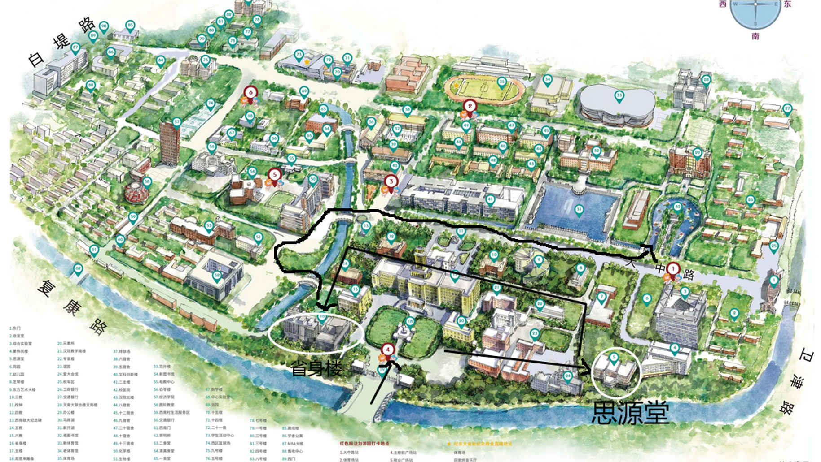
CONTENTS
Sculpture of Prime Minister Zhou
the Xingsheng Building
the site of
Siyuan Hall
HorseShoe Lake Jialing school

Slide 3

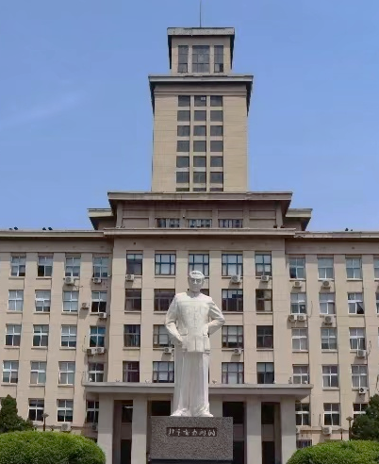

PART
01
Sculpture of Prime Minister Zhou
///Time goes back to 1919
After the May Fourth Movement broke out in 1919…

Slide 4

Participate with Zhou
NANKAI
UNIVERSITY
Oppose the the Northern Warlord government
Communist Party of China
Being arrested
"Awakening Society"
Later, he united and led progressive in the US and Europe to join the Communist Party of China.
The experience in the prison made Zhou more firm in his ideal of reading for the rise of China.
Zhou led more than 5,000 students in Tianjin petition the Government office
He became the leading backbone of the student movement.

Slide 5
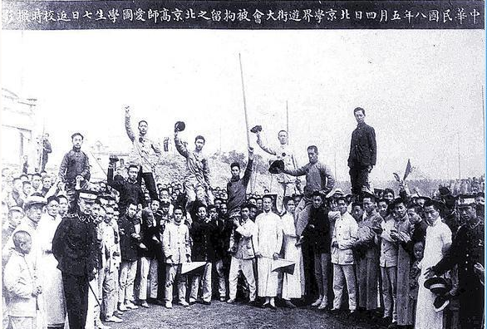

Success
E
N
D
After the founding of the People's Republic of China, he also assisted Mao Zedong in leading the all-round construction of the People's Republic of China, and made great efforts in running the Party, state and army, as well as in the fields of internal affairs, national defense and foreign affairs.

Slide 6
PART
02
Siyuan Hall
///Time goes back to the Anti -Japanese war…

Slide 7
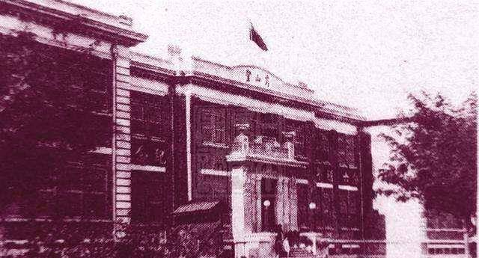
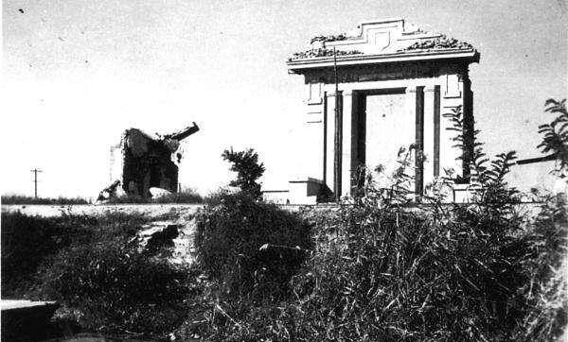
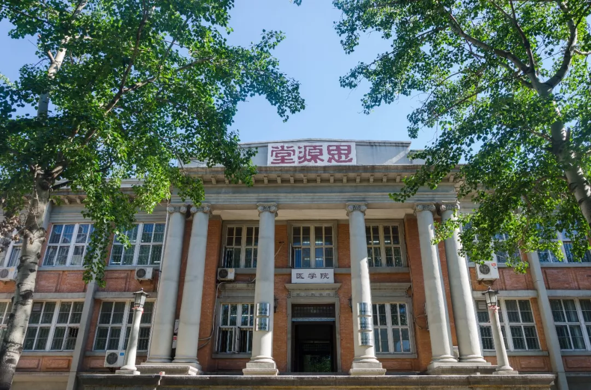
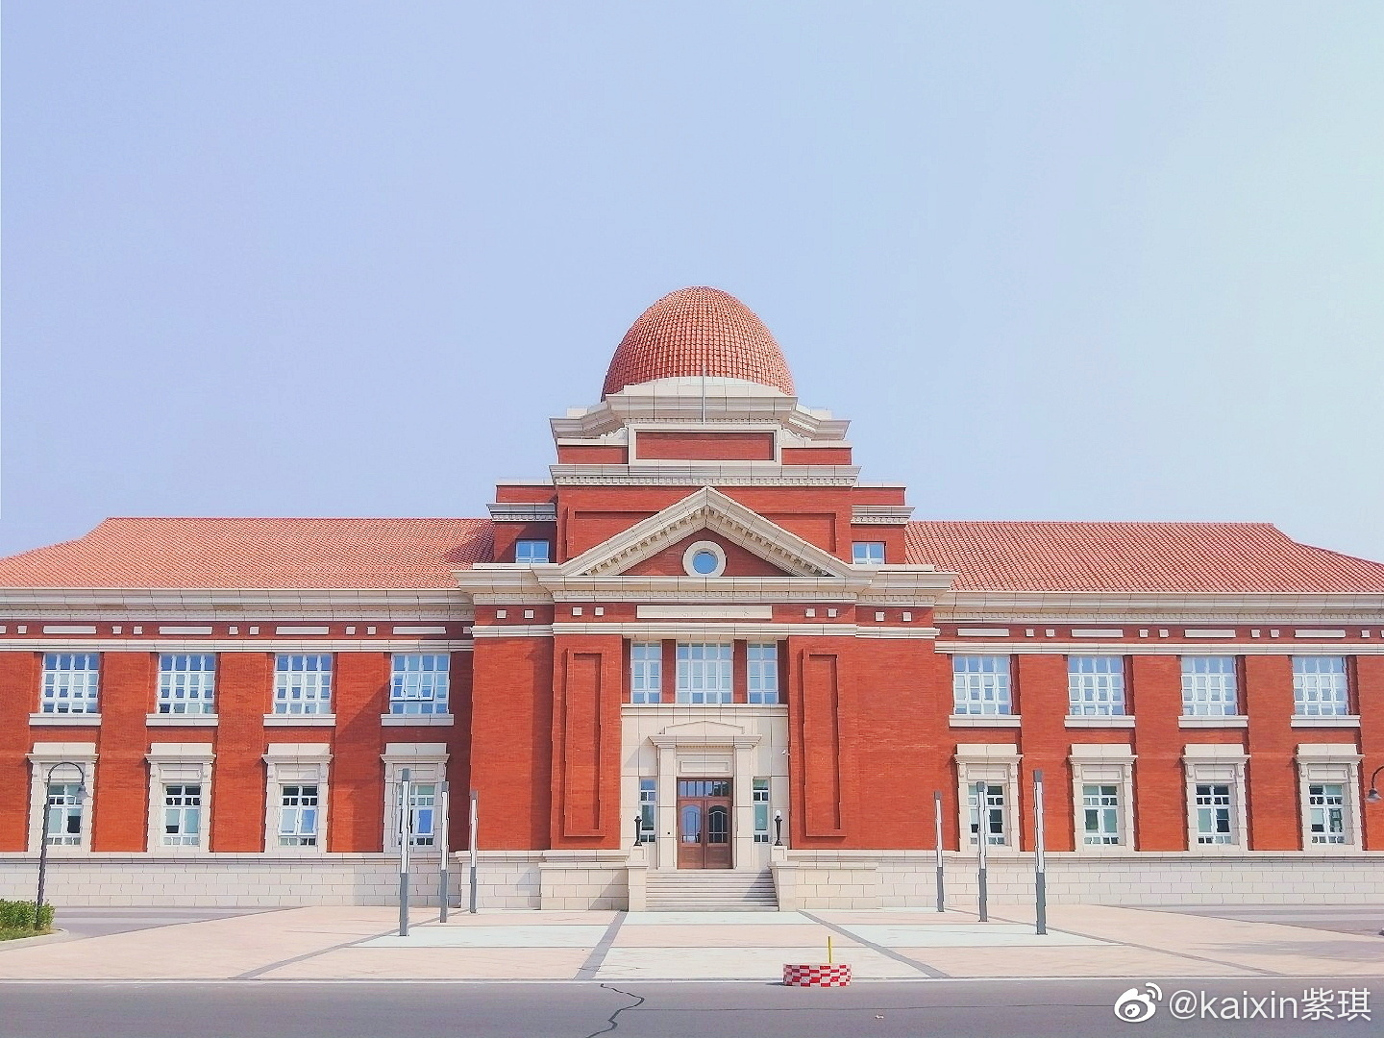
Struggling
Suffering
Destroyed
Reunion
Miracle
An important bell inscribed with the Diamond Sutra on the nankai campus was towed away by the Japanese.
On July 29, 1937, The Japanese army bombed Nankai University.
At this time, Nankai University, Tsinghua University and Peking University moved south to form Changsha Temporary University
In 1938,the temporary university was renamed National Southwest Associated University.

Slide 8
significance
They showed us what Chinese college students should look like. The southwest Associated University persisted until the victory of the Anti-Japanese War.
It enabled China's higher education to continue to sing in the southwest frontier area of China and passed on civilization from generation to generation.
From then on, Nankai opened a new chapter in its history.

Slide 9
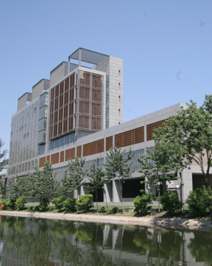
PART
03
Xingshen Building
Time has come to 1985...

Slide 10
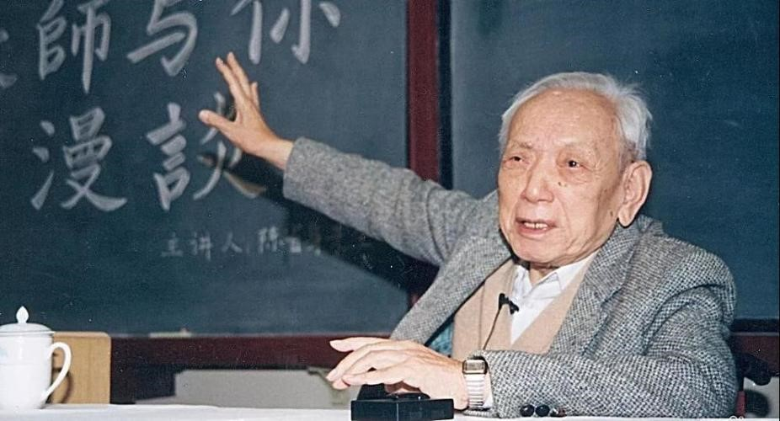

Join the Research
01
Mathematics
When the mathematician Chen xingshen joined Nankai University , Nankai Mathematical Research Institute was established. And at this time it’s so lucky of you to attend Mr.Chen’s lecture which covers numerous areas of mathematics.
02
Amazement
Through the observation of the part of math, you may recognize the whole university of Rigorous style of study and research.

Slide 11
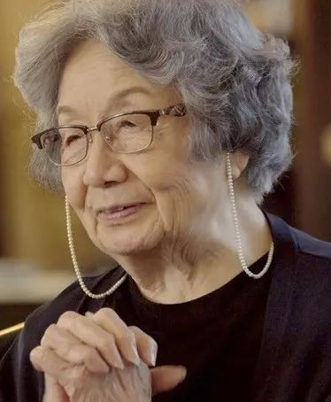
PART
04
Jialing school &HorseShoe Lake
Now let’s back to reality…

Slide 12
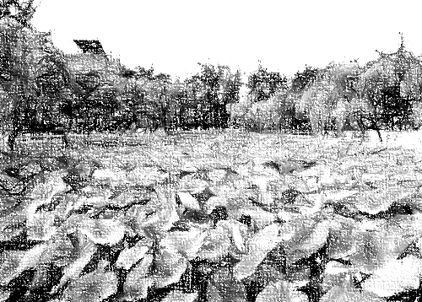

lecture
+
You will have a chance to appreciate the charm of poetry. A lecture delivered by a distinguished researcher of Chinese poetry who selected to move to China will be held at the last stop of this trip, Jialing academy, a modern building in Chinese classical style.
+
In the process of this lecture, you can personally not only feel the history, culture and the spirit of Nankai University, but also be conscious of the deep roots of traditional Chinese culture.
=

Slide 13
Last…
Arriving here, our trip through history is almost over. Visiting scenic spots, exploring the history behind them, we hope that you may fall in love with Nankai, and that’s the meaning of our struggle.

Slide 14
W
E
L
C
O
M
E
THANK YOU
允公允能
日新月异
T
O
N
K
U

